Slide 1
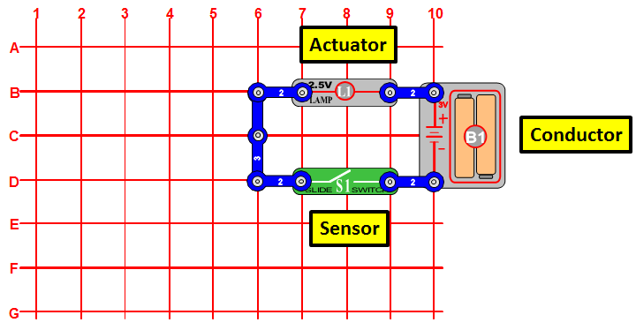
Notes:
A conductor is an object or type of material that allows the flow of charge (electrical current) in one or more directions. Devices which perform an “Input” function are commonly called Sensors because they “sense” a physical change in some characteristic that changes in response to some excitation, for example heat or force and convert that into an electrical signal. Devices which perform an “Output” function are generally called Actuators and are used to control some external device, for example movement or sound.
When you close the slide switch (sensor), current flows from the batteries through the lamp and back to the battery through the switch. The closed switch completes the circuit – this is called a closed circuit. When the slide switch is opened, the current can no longer flow back to the battery, so the lamp goes out – also called an open circuit.

Slide 2
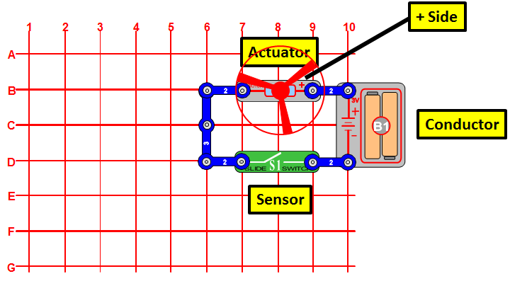
Notes:
When you close the slide switch (S1), current flows from the batteries (B1) through the motor (M1) making it rotate. Place the fan blade on the motor shaft and close the slide switch. DC motors are used in all the battery powered equipment requiring rotary motion, such as drills, electric toolbrush, and toy trains that run on batteries.

Slide 3
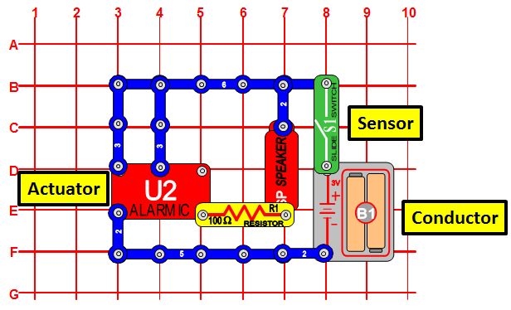
Notes:
When you close the slide switch (S1), the circuit (U2) should start sounding an up-down siren. Switch the sound on and off quickly and see if you can create even different effects.

Slide 4
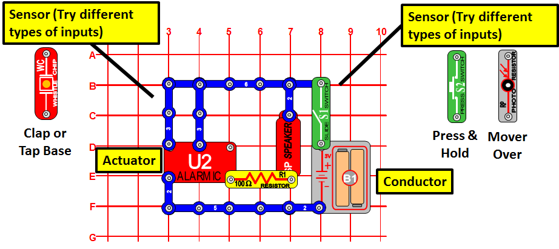
Notes:
Try adding and replacing the different types of sensors. Clap your hands close to the whistle chip (WC) or tab the base with your finger. Press and hold the press switch (S2) several times. Move your hand over the photoresistor (RP) and wave it.

Slide 5
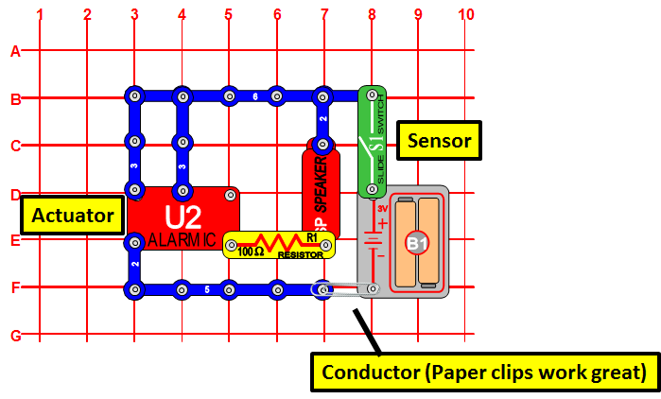
Notes:
Some materials can carry the flow of electricity better than others. Try a paper clip for example, see if it can close the circuit. When you place a metal paper clip across the terminals, current flows from the batteries (B1) through the alarm, and back to the battery. The paper clip completes the circuit and current flows through the alarm. Place your fingers across the terminals and the LED does not light. Your body has too high a resistance to allow enough current to flow to light the LED. If the voltage (electrical pressure) would be higher, then current could be pushed through your fingers and the LED would light.

